Slide 1
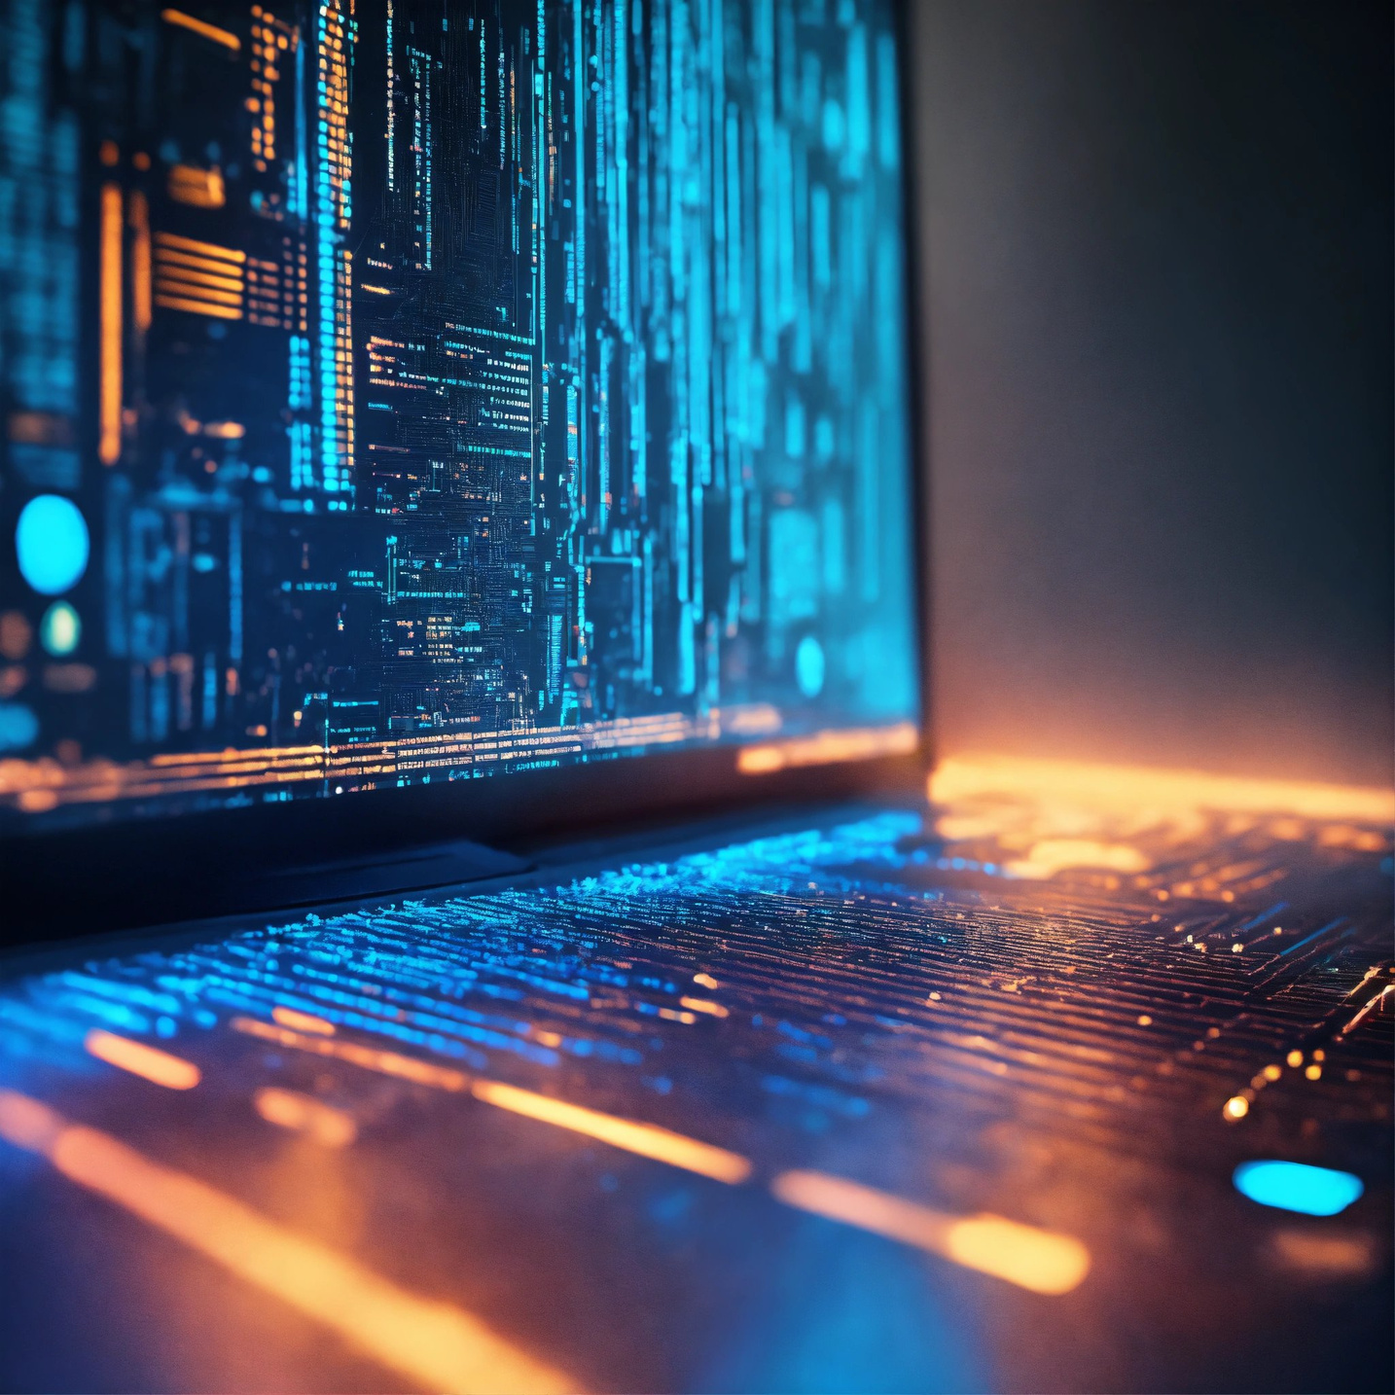

THE ELECTRONIC ERA
OF COMPUTING
Name- SK Moin Hossain
Roll no- 27100123050
Department- Computer Science and Engineering
Subject-Data Structure & Algorithm
Subject code- PCCCS301
College- Camelia Institute of Engineering and Technology
1

Slide 2

Contents
Introduction
Early Electronic Computers
Transistors and Integrated Circuits
Microprocessors
Personal Computers (PCs)
Graphical User Interface (GUI)
Internet and Networking
Mobile Computing
Role of Cloud Computing and Artificial Intelligence
Future Trends
2

Slide 3
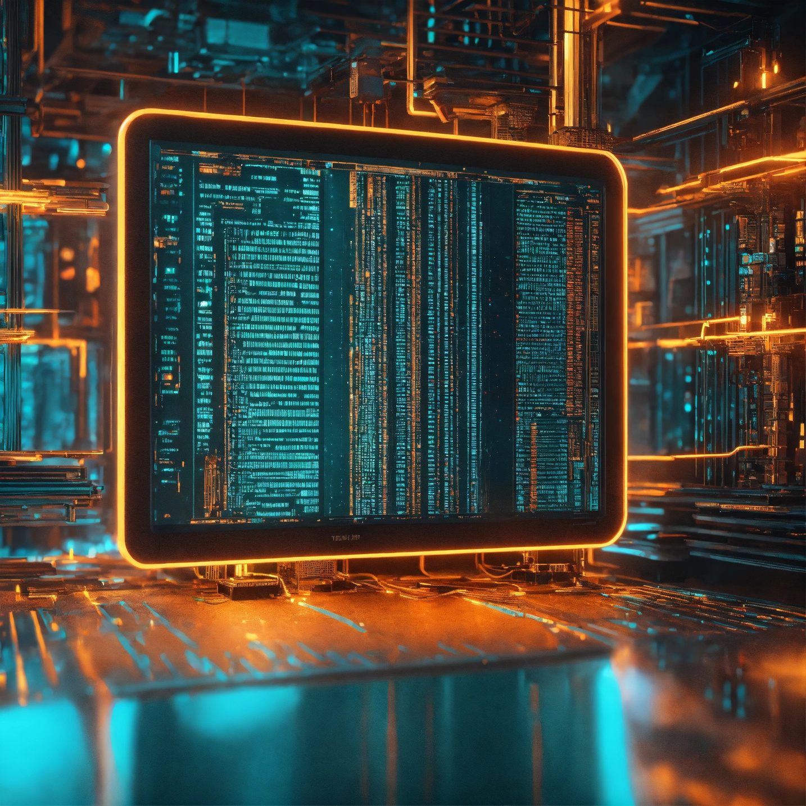
Introduction
Computing's fascinating journey through time has brought us to the pivotal "Electronic Era." This transformative period is marked by the emergence of electronic computing systems that have redefined the way we process information. From the early behemoths like ENIAC and UNIVAC, which left an indelible mark on the historical landscape with their imposing size and limited capabilities, the trajectory of computing underwent a seismic shift. The game-changing transistor revolution followed, bringing about a radical reduction in size coupled with a substantial boost in processing power. Subsequently, integrated circuits played a crucial role in further miniaturization and the enhancement of electronic design. As we delve into this era, the narrative unfolds with microprocessors assuming a pivotal role, catalyzing the rise of personal computers in the dynamic landscape of the 1970s and 1980s. Notably, companies such as Apple and IBM emerged as instrumental architects, shaping the contours of this electronic era.
3

Slide 4
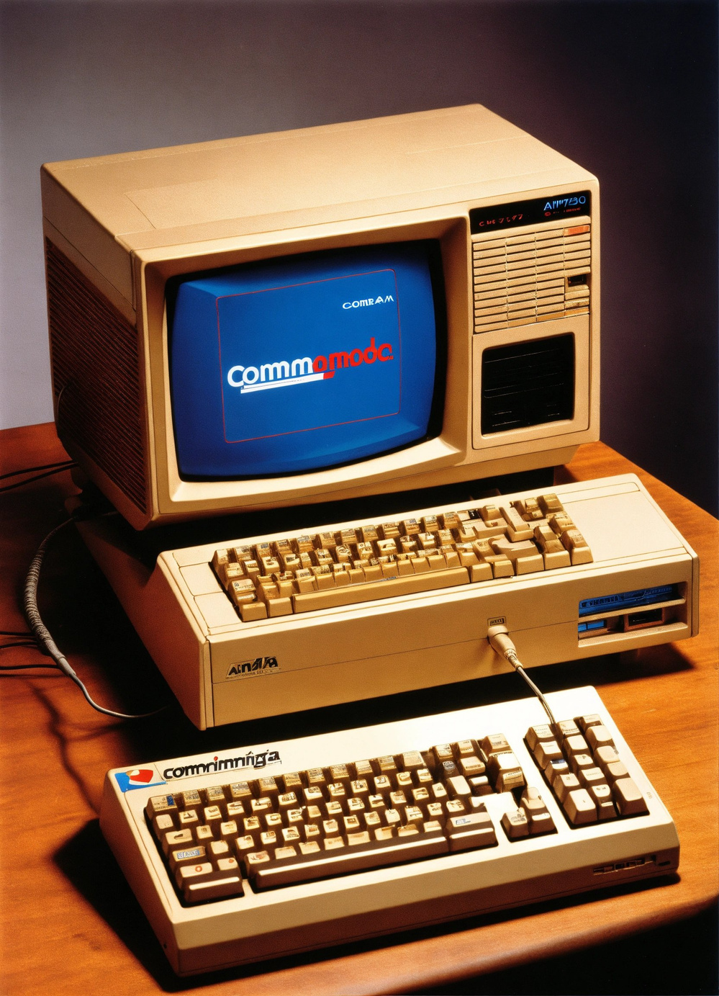
Early Electronic Computers
Early electronic computers, including ENIAC and UNIVAC, left an indelible mark on the historical landscape. These pioneering machines, characterized by their massive size and limited capabilities, laid the groundwork for the electronic era of computing. ENIAC, completed in 1945, was the world's first general-purpose electronic digital computer, encompassing an astonishing 30-ton weight and a vast array of vacuum tubes. UNIVAC, introduced in 1951, became the first commercially produced computer, further solidifying the transition from mechanical to electronic computing. Despite their limitations, these early computers represented a leap forward, setting the stage for subsequent advancements in electronic design and paving the way for the transformative era that followed.
4

Slide 5
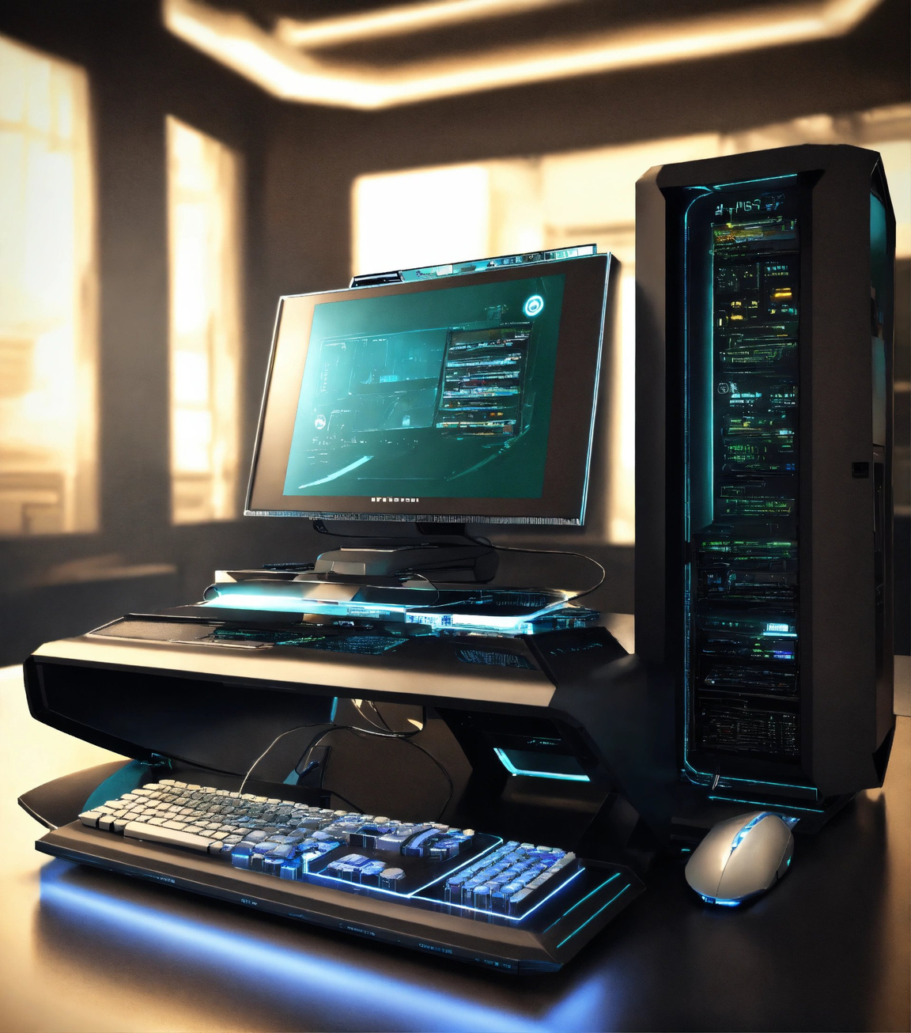
Personal Computers (PCs)
The electronic era saw a pivotal shift with the advent of personal computers (PCs). Early in the 1970s and 1980s, microprocessors played a transformative role, empowering the development of compact, user-friendly PCs. These devices, which were no longer confined to large, centralized systems, brought computing capabilities directly to individuals. Companies like Apple and IBM emerged as key players in this revolution, introducing iconic products that set the stage for the widespread adoption of personal computing. The accessibility and versatility of PCs reshaped how people interacted with technology, laying the foundation for the digital age we experience today.
7

Slide 6
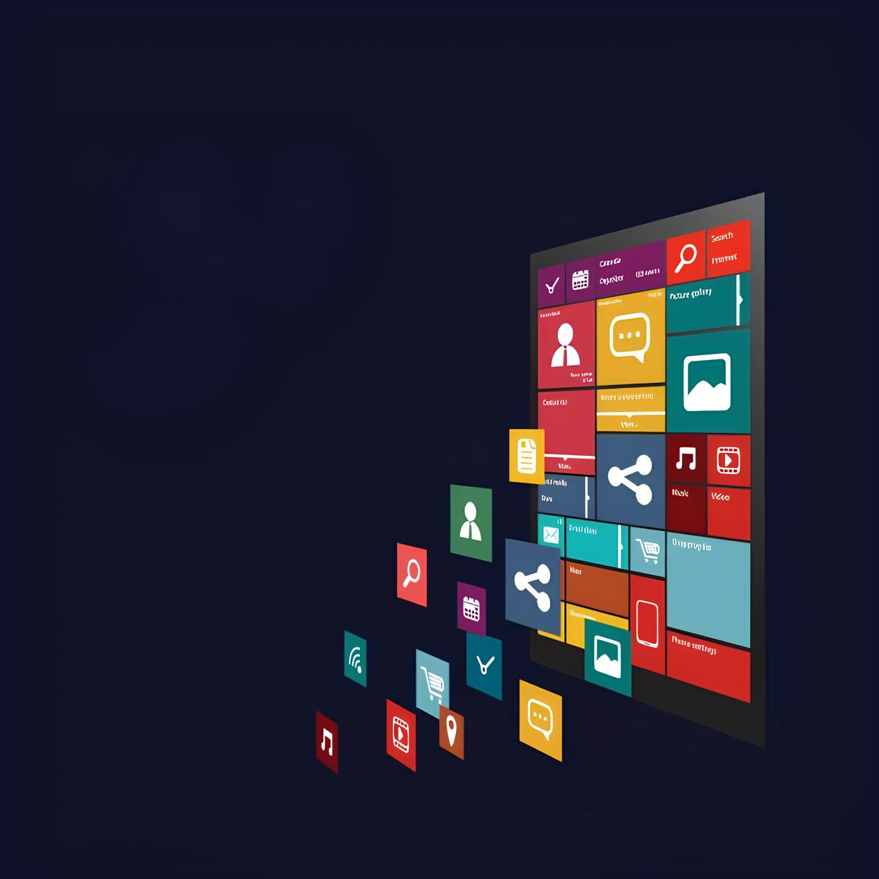
Graphical User Interface (GUI)
The advent of Graphical User Interface (GUI) marked a crucial turning point in computing. Before GUI, interaction with computers primarily relied on text-based commands. GUI introduced a visually intuitive approach, employing icons, windows, and pointers for user interaction. This shift enhanced accessibility for a broader audience, making computing more user-friendly and less reliant on command-line expertise. GUI's introduction in the 1980s, notably with systems like Apple's Macintosh and Microsoft's Windows, revolutionized the user experience, setting a standard for modern computer interfaces that persists to this day.
8

Slide 7
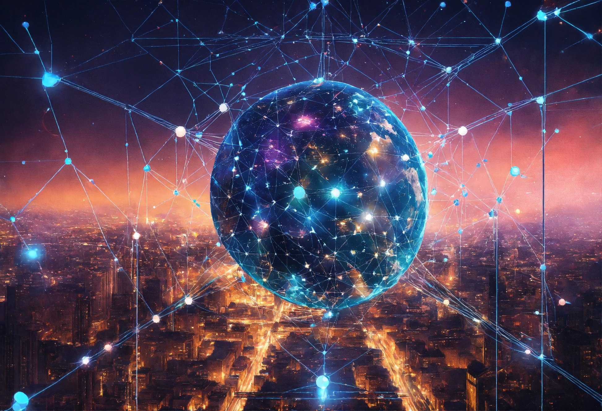
Internet and Networking
The emergence of the Internet and networking has been a transformative force in the electronic era of computing. The interconnected web of computers has revolutionized communication, information sharing, and global connectivity. From its early days as a research and military tool to its widespread adoption in the business and personal spheres, the Internet has become an indispensable part of our daily lives. Networking technologies have facilitated seamless data exchange, allowing for real-time collaboration and the sharing of resources. The impact of the Internet on society, commerce, and education is profound, fostering a more interconnected and interdependent world.
9

Slide 8
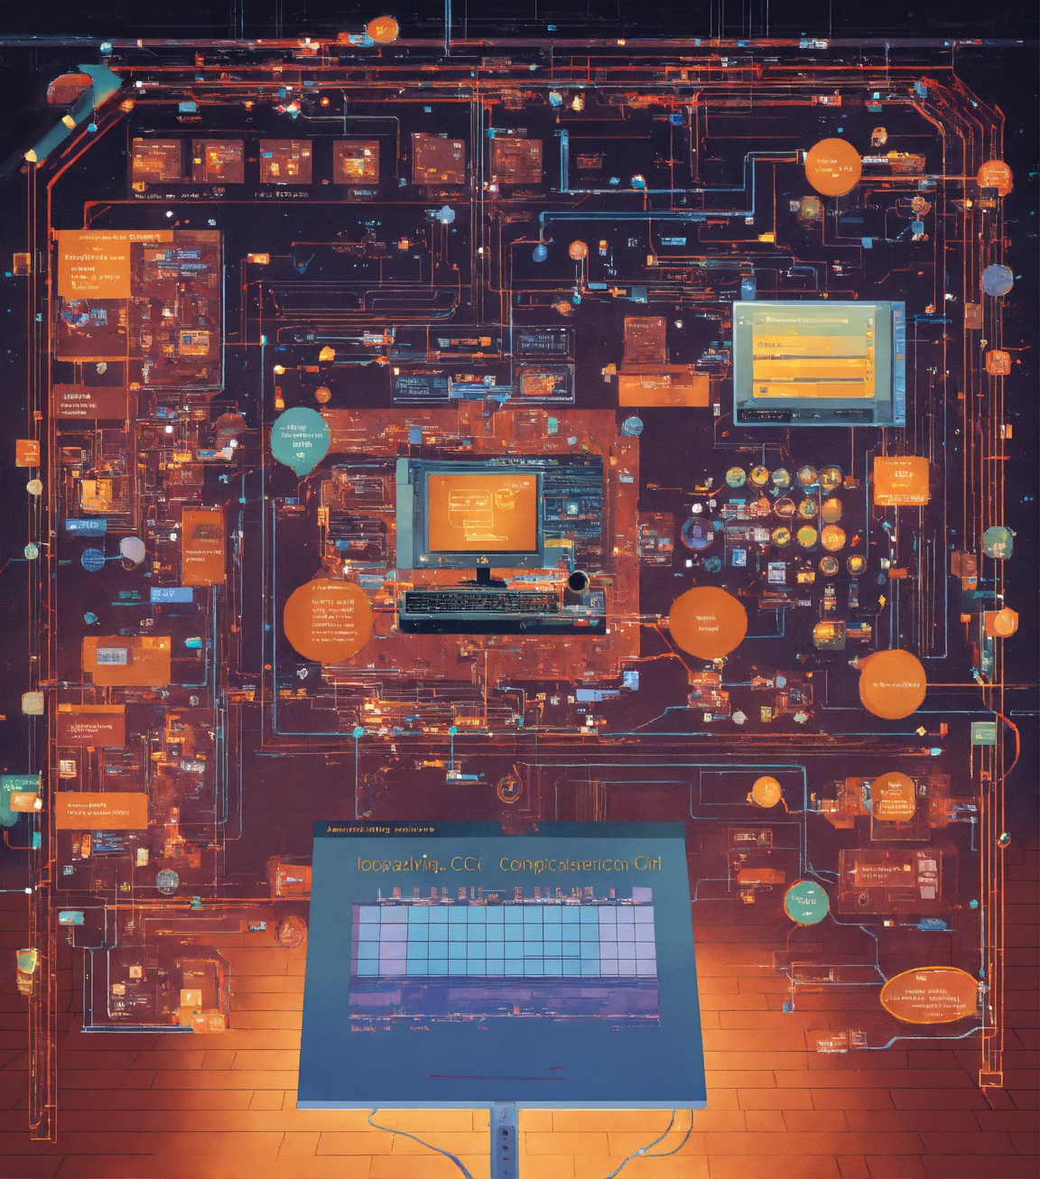
Future Trends
Looking ahead, the landscape of computing continues to evolve, presenting exciting possibilities. One prominent trend on the horizon is the exploration of quantum computing, a paradigm that harnesses the principles of quantum mechanics to perform computations at unprecedented speeds. Quantum computers hold the potential to revolutionize fields such as cryptography, optimization, and scientific simulations. Additionally, as we move forward, the integration of augmented reality (AR) and virtual reality (VR) into computing environments is becoming increasingly prevalent. These immersive technologies are poised to reshape user experiences, from gaming and entertainment to education and professional collaboration. With ongoing advancements in artificial intelligence and machine learning, we anticipate a future where computing systems become more intelligent, adaptive, and capable of addressing complex challenges across diverse industries. As we navigate these forthcoming trends, the electronic era of computing is set to continue its transformative journey into uncharted territories.
12

